Slide 1

DSO 545 – Final Project
Los Angeles
311
Call Center
12/07/2016
By
Aadhar Sharma
Matt Higashi
Michelle Offir Geveye
Neha Keshari
Siddarth Jain

Slide 2

Executive Summary
Our purpose is to understand LA 311 data trends in order to identify potential areas to improve 311 services. We will examine the overarching trends and will recommend actionable strategies based on the insights gathered.
Performance Measures
Who are our users:
trends in Mobile OS
Service Request by OS
Request differences by OS
Where is the demand:
Analysis by Departments
Services Requested
Cycle Times
Actions Taken
Times of demand
How is our response:
Request Types vs. Sources
Analysis of Response Times
Awareness of the App
Recommendations

Slide 3
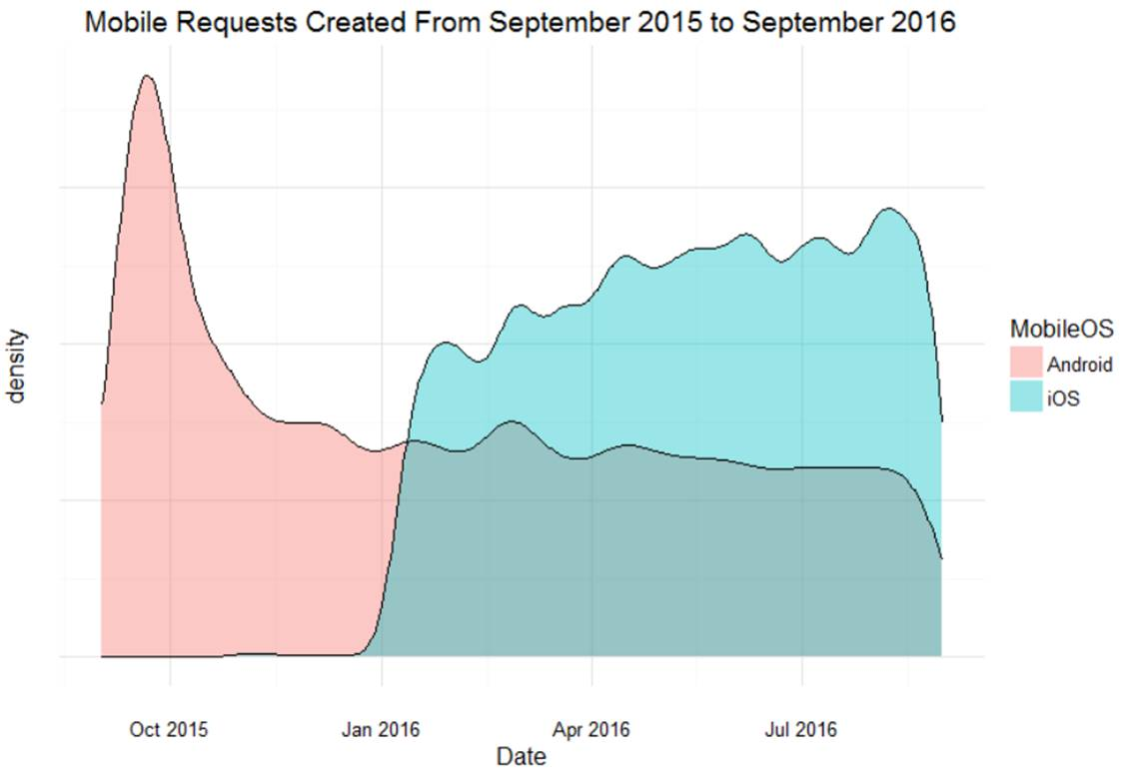
Trends in Mobile OS usage
Declining Android usage, and increasing iOS density
Assumes app was launched in Jan 2016
Once the iOS was launched, we see a decrease in Android usage
Observations
We see a high peak in Oct, this corresponds to an app promotion through social media
Insights

Slide 4
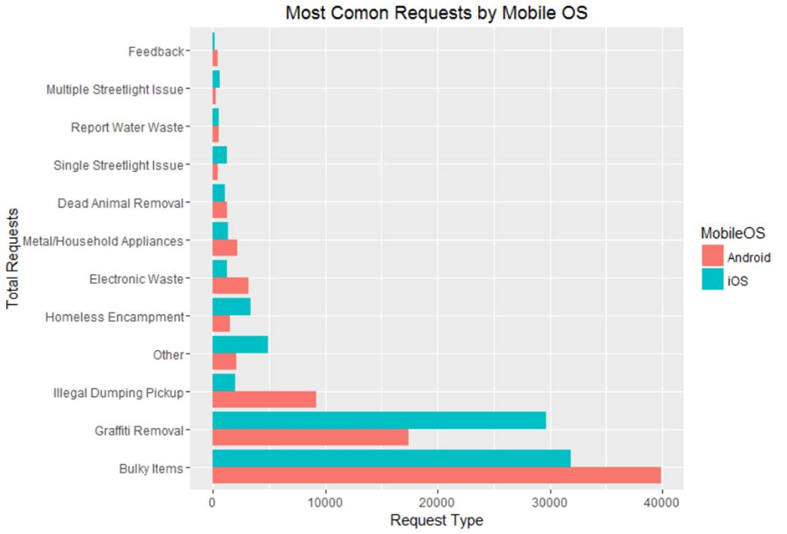
Android vs. iOS Requests
12% more
bulky item removal requests
Android
27% more
requests for graffiti removal
iOS

Slide 5
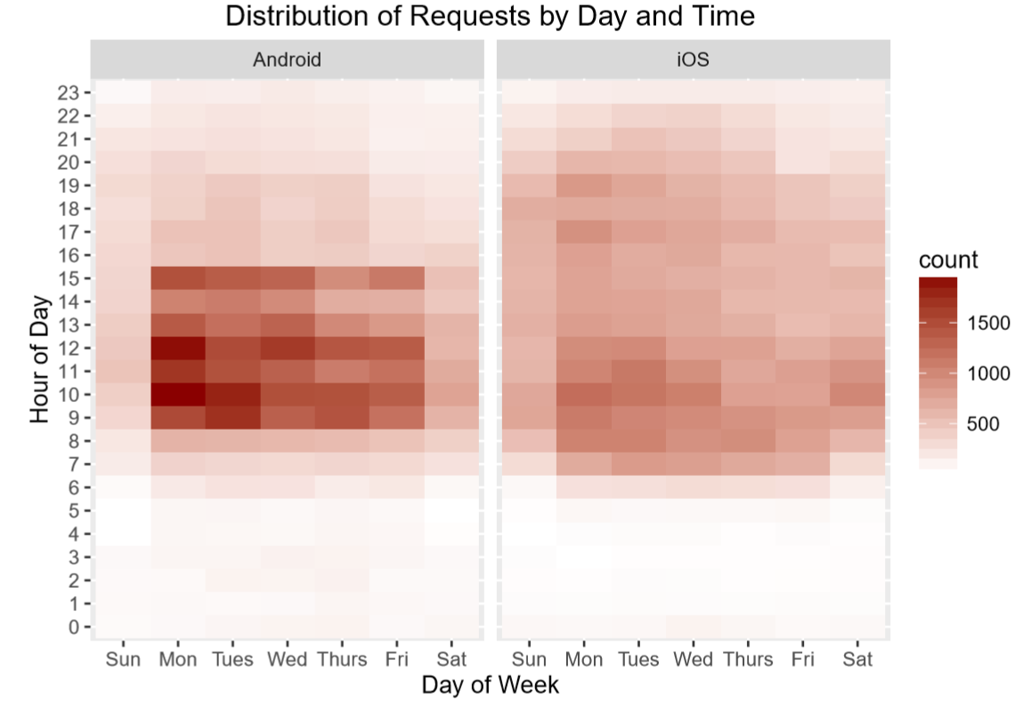
Differences in requests for mobile OS
Greater weekday density with the Android OS
Monday has highest concentration of requests
More calls are made in the beginning of the week
Wider time distribution of iOS requests
Highest concentration Mon-Wed mornings
Calls spread to later hours than Android

Slide 6
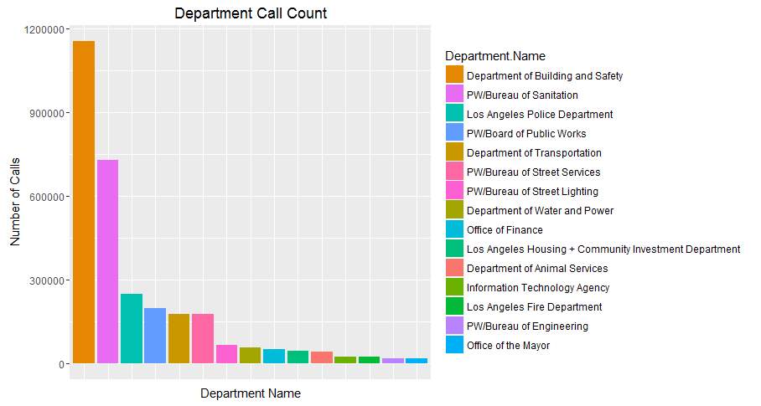
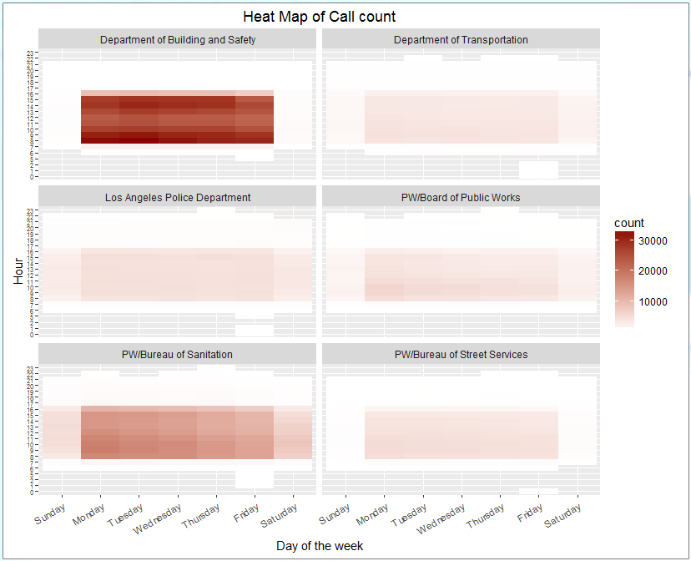
Calls by Department
LADBS and Bureau of Sanitation
Highest concentration of calls
Strong Mon-Fri demand
Calls are highest in the morning hours
Observations
LAPD, PW, Street Services, & LADOT
LADOT even distribution during weekdays
PW higher concentration in morning hours
Street Services, weekend calls are negligible

Slide 7
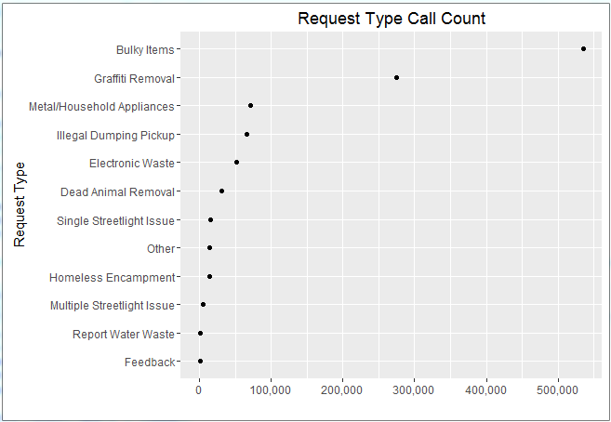
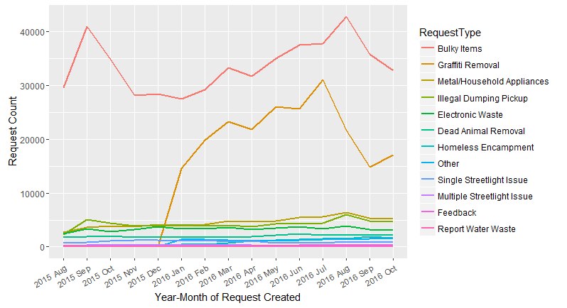
Most requested services
Request Count Trends
Observations
Bulky Items account for 49% of requests
Graffiti Removal accounts for 24% of requests
Over time, request for bulky items and graffiti removal are increasing
___________________
___________________
___________________
___________________
Recommendations

Slide 8
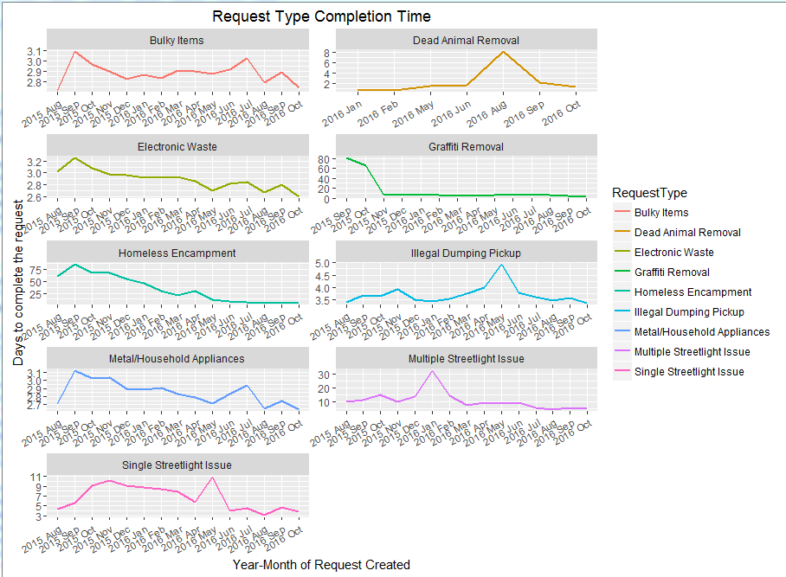
Cycle time for Requested Services
Request Type CycleTime
Peaks indicate that these requests were not handled efficiently in that particular month
Observations
We observe a general trend of improved response efficiency
Average CycleTime : 3.5 days, SD: 9.5 days
A request can be serviced in 0 to 22 days with 95% CI
Request Types with high CycleTime:
Homeless Encampment – 16 days
Streetlight issue ( Single: 7 days, Multiple: 11 days)

Slide 9
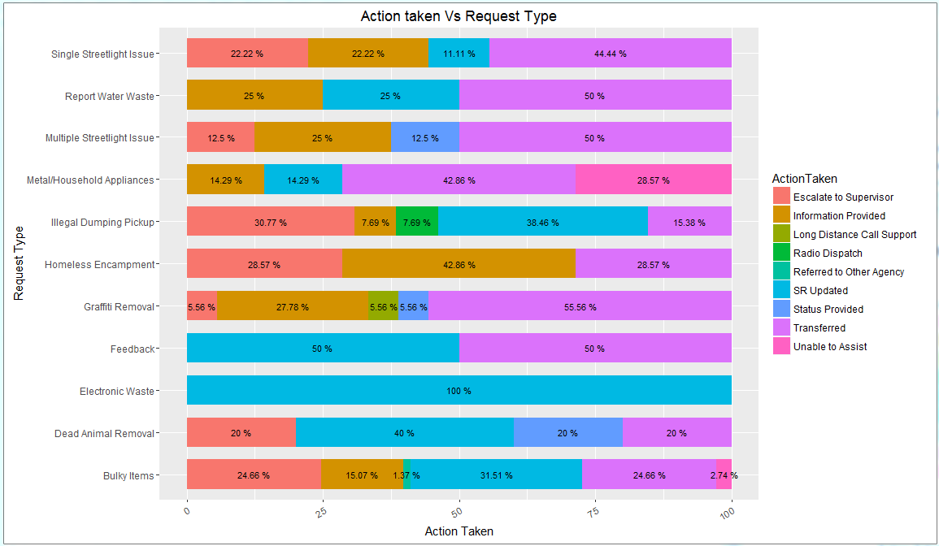
Actions by request type
Requests for Graffiti removal are being transferred at 55%
Observations
Illegal Dumping and Homeless Encampment requests get escalated approx. 30% of the time

Slide 10
Heatmap for requests types
Bulky Items and Graffiti Removal requests are handled throughout the week (primarily 8am-5pm)
For all item request, nearly 80% of calls are serviced between Mon-Wed

Slide 11
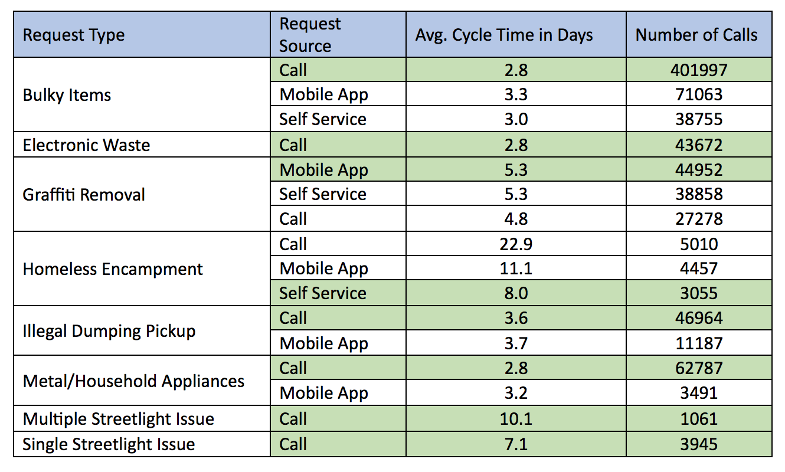
Request Types vs. Request Source
Response time varies between mobile app vs. calls
Bulky Items are best serviced via Calls
Graffiti removal is best serviced through the mobile app
Homeless encampment – self-service

Slide 12
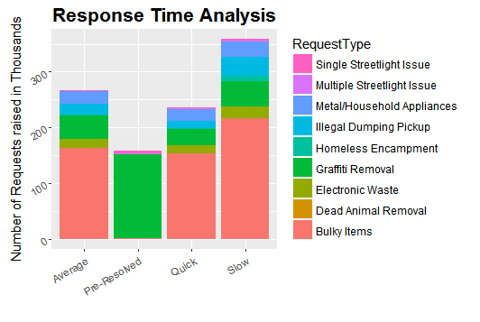
Analysis of response time
Response Time | CycleTime | Requests | % contribution
Pre-Resolved | NA | 158643 | 15.5%
Quick | < 1 day | 236536 | 23.2%
Average | < 3 days | 266663 | 26.1%
Slow | > 3 days | 359532 | 35.2%
Majority of Response time are slow (greater than 3 days)
Over 98% of pre-resolved cases are graffiti removal

Slide 13
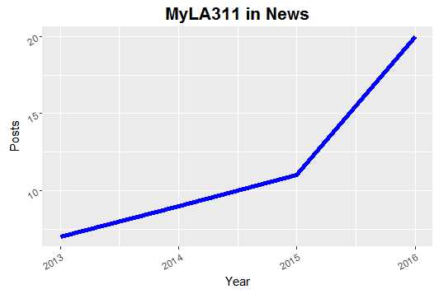
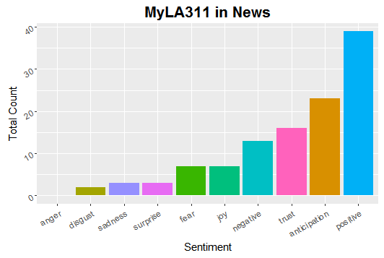
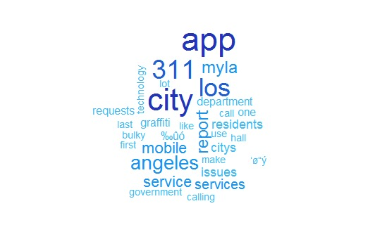
News trends for 311 app
311 has been in the news 47 times both nationally and internationally
Sentiment analysis shows positive response to app
Popularity has increased significantly in the last year

Slide 14
Recommendations
Optimize work resources for Monday through Wednesday
Distribute requests over the weekend by increasing work shifts
Focus Primarily on Department of Building and Safety
Encourage Employee Self-Reporting over public reporting
Promote smart phone application usage as call volume is still significant
Cycle times for bulky items have been increasing (with summer months at the highest) – be prepared for handling increased requests
Incorporate better reporting procedures for homeless encampment and illegal dumping to reduce the high rate of report escalations to managers in the future

Slide 15
Appendix

Slide 16
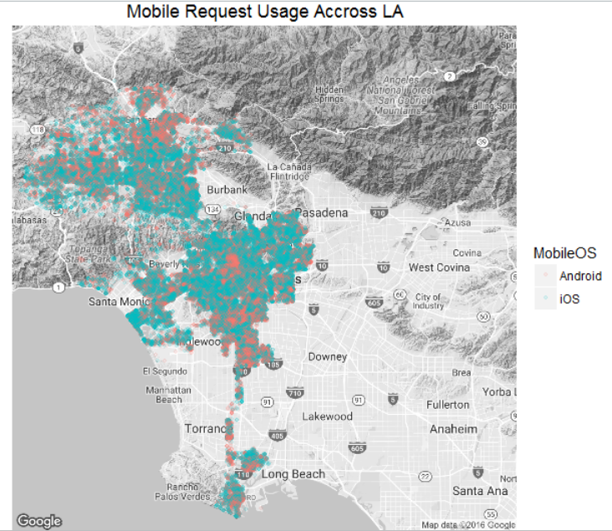
Geographical Distribution of Requests

Slide 17
Geographic distribution of mobile usage

Slide 18
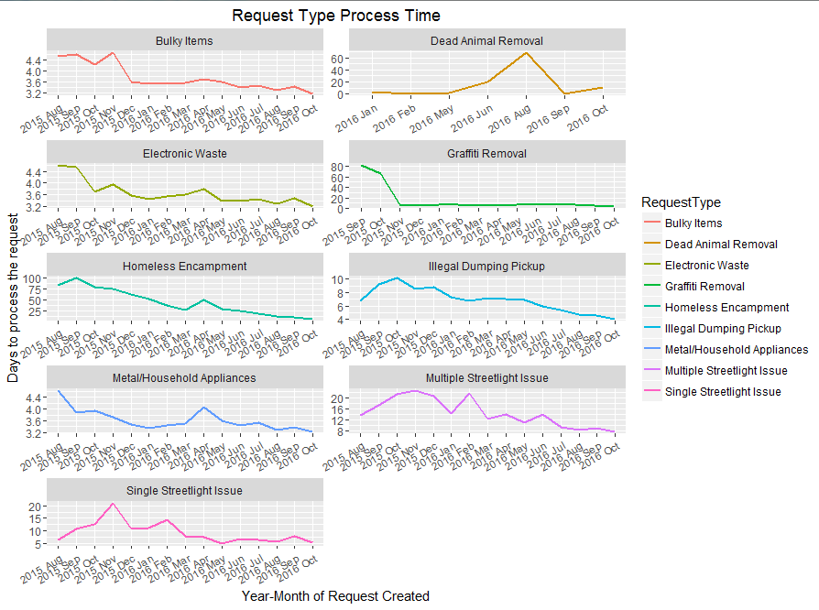
Downward trend for process time

Slide 19
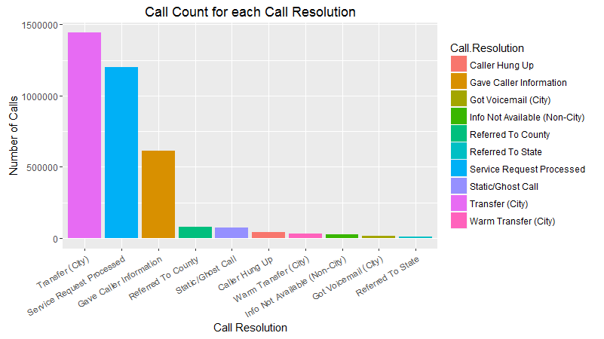
Distribution of Call Resolutions
Calls were transferred to other cities 40% of the time
34% of calls were processed for service

